Slide 1
CAUSAL LTI SYSTEMS DESCRIBED BY DIFFERENTIAL AND DIFFERENCE EQUATIONS
An extremely important class of CT systems is that for which the input and output are related through a linear constant-coefficient differential equation
Equation of this type arise in the description of a wide variety of systems and physical phenomena.
Correspondingly, an important class of DT systems is that for which the input and output are related through a linear constant-coefficient difference equation.
Equations of this type are used to describe the sequential behaviour of many different processes.

Slide 2
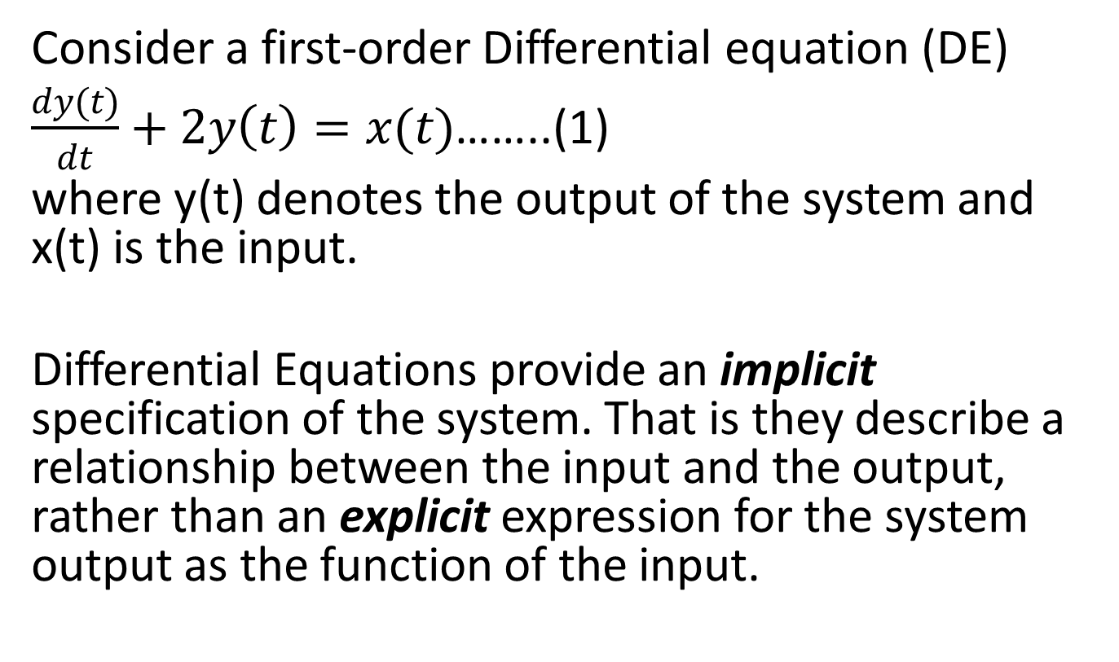
Linear Constant-Coefficient Differential Equation
Consider a first-order Differential equation (DE)
$\frac{dy(t)}{dt}+2y\left(t\right)=x(t)$……..(1)
where y(t) denotes the output of the system and x(t) is the input.
Differential Equations provide an implicit specification of the system. That is they describe a relationship between the input and the output, rather than an explicit expression for the system output as the function of the input.

Slide 3
By solving the DE we obtain an explicit expression, we however will need more information than that provided by the DE alone
We must specify one or more auxiliary conditions in order to obtain an explicit expression.
Different choices for these auxiliary conditions would lead to different relationships between the input and the output.

Slide 4
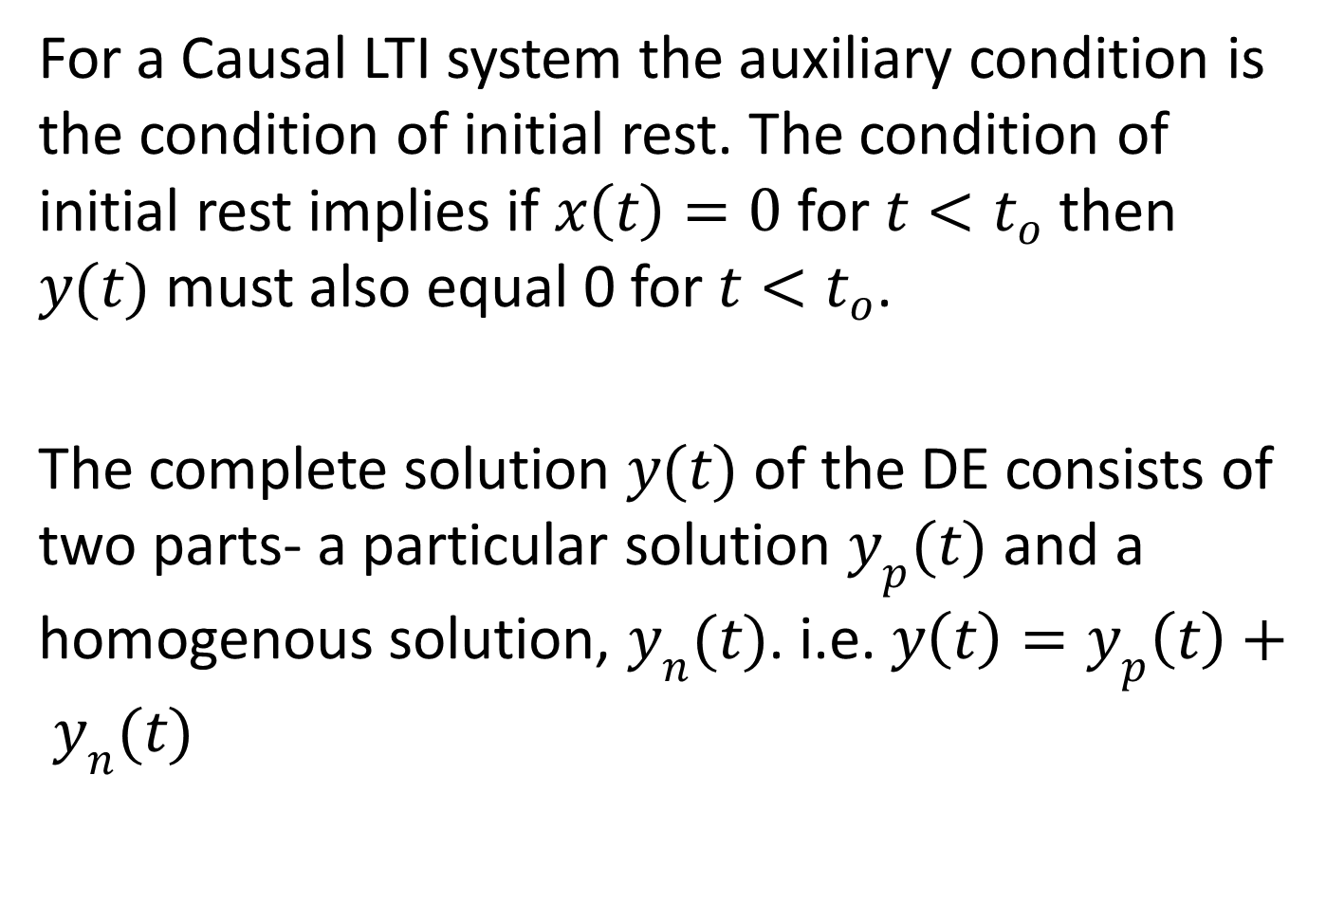
For a Causal LTI system the auxiliary condition is the condition of initial rest. The condition of initial rest implies if $x\left(t\right)=0$ for ${t<t}_{o}$ then $y(t)$ must also equal 0 for ${t<t}_{o}$.
The complete solution $y(t)$ of the DE consists of two parts- a particular solution $y_{p}(t)$ and a homogenous solution, $y_{n}(t)$. i.e. $y\left(t\right)=y_{p}\left(t\right)+ y_{n}(t)$

Slide 5
The homogeneous solution is a solution to the differential with the input set to zero. The homogeneous solution is often referred to as the natural response of the system.

Slide 6
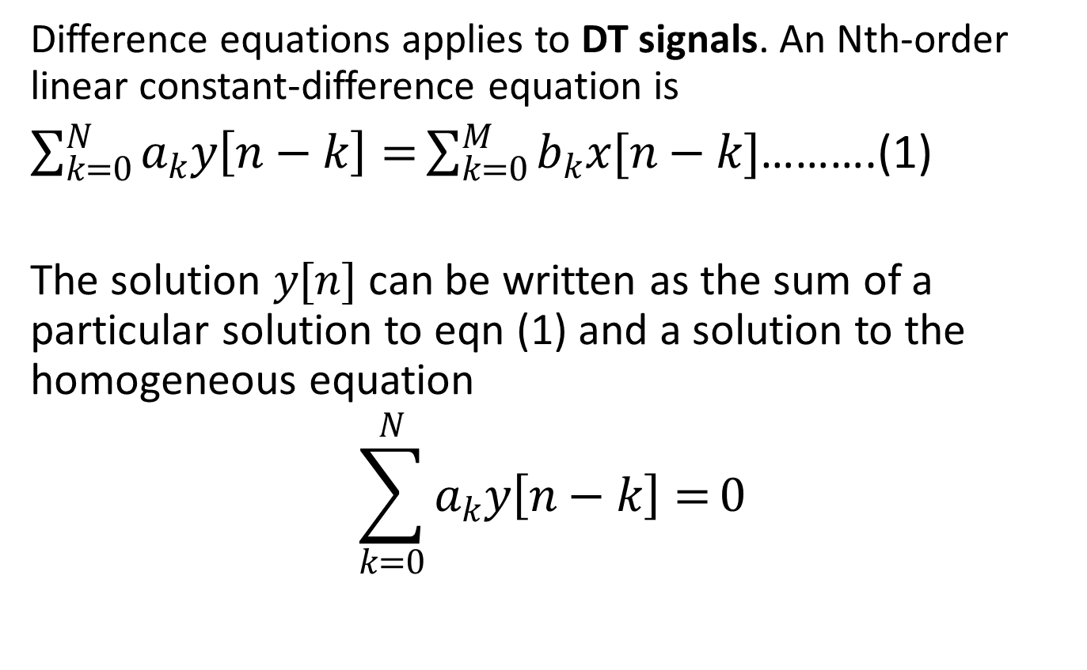
Linear Constant-Coefficient Difference Equation
Difference equations applies to DT signals. An Nth-order linear constant-difference equation is
$\sum_{k=0}^{N}{a_{k}y\left[n−k\right]=}\sum_{k=0}^{M}{b_{k}x[n−k]}$……….(1)
The solution $y[n]$ can be written as the sum of a particular solution to eqn (1) and a solution to the homogeneous equation
$$\sum_{k=0}^{N}{a_{k}y\left[n−k\right]=}0$$

Slide 7
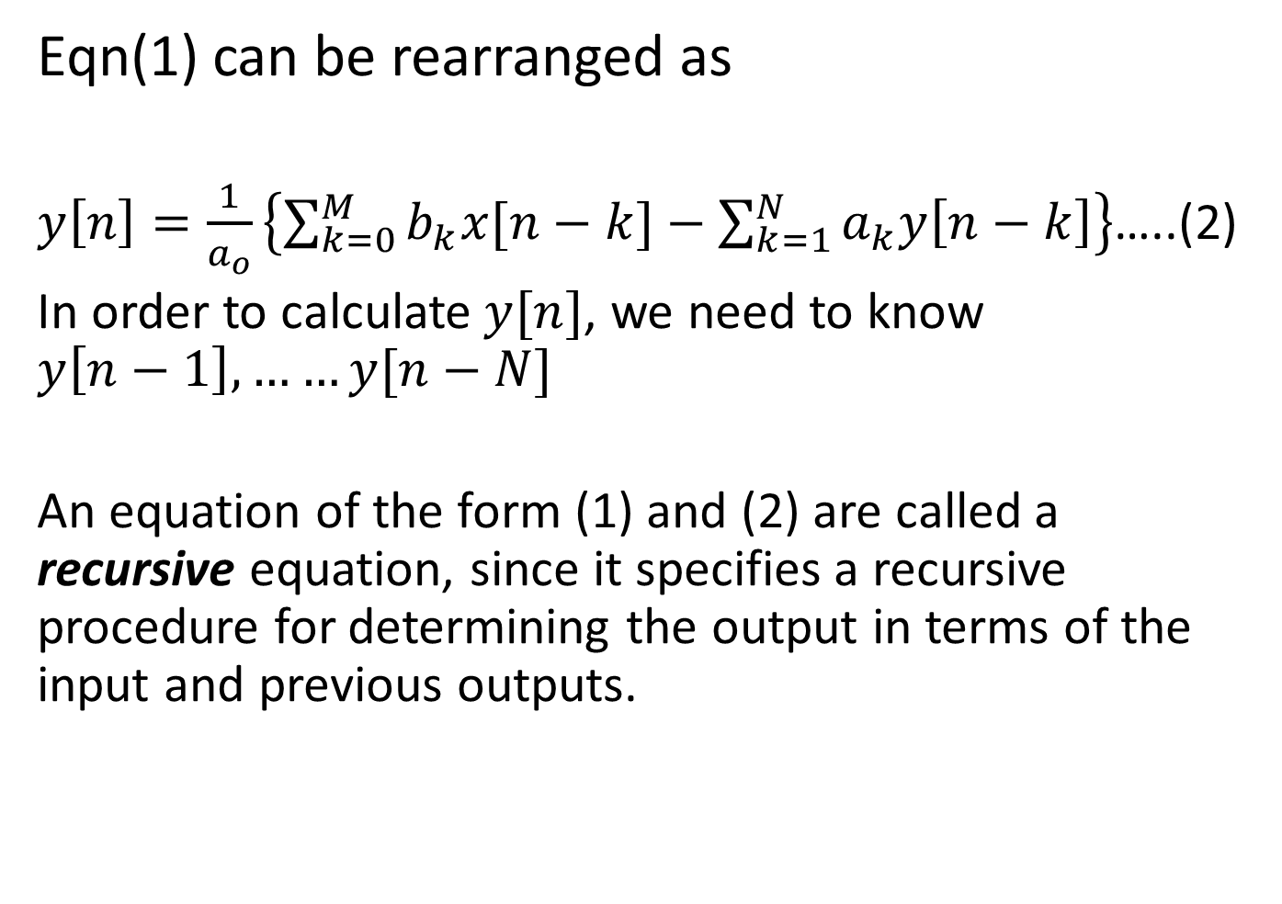
Eqn(1) can be rearranged as
$y\left[n\right]=\frac{1}{a_{o}}\left\{\sum_{k=0}^{M}{b_{k}x[n−k]}−\sum_{k=1}^{N}{a_{k}y\left[n−k\right]}\right\}$…..(2)
In order to calculate$y[n]$, we need to know $y\left[n−1\right],……y[n−N]$
An equation of the form (1) and (2) are called a recursive equation, since it specifies a recursive procedure for determining the output in terms of the input and previous outputs.

Slide 8
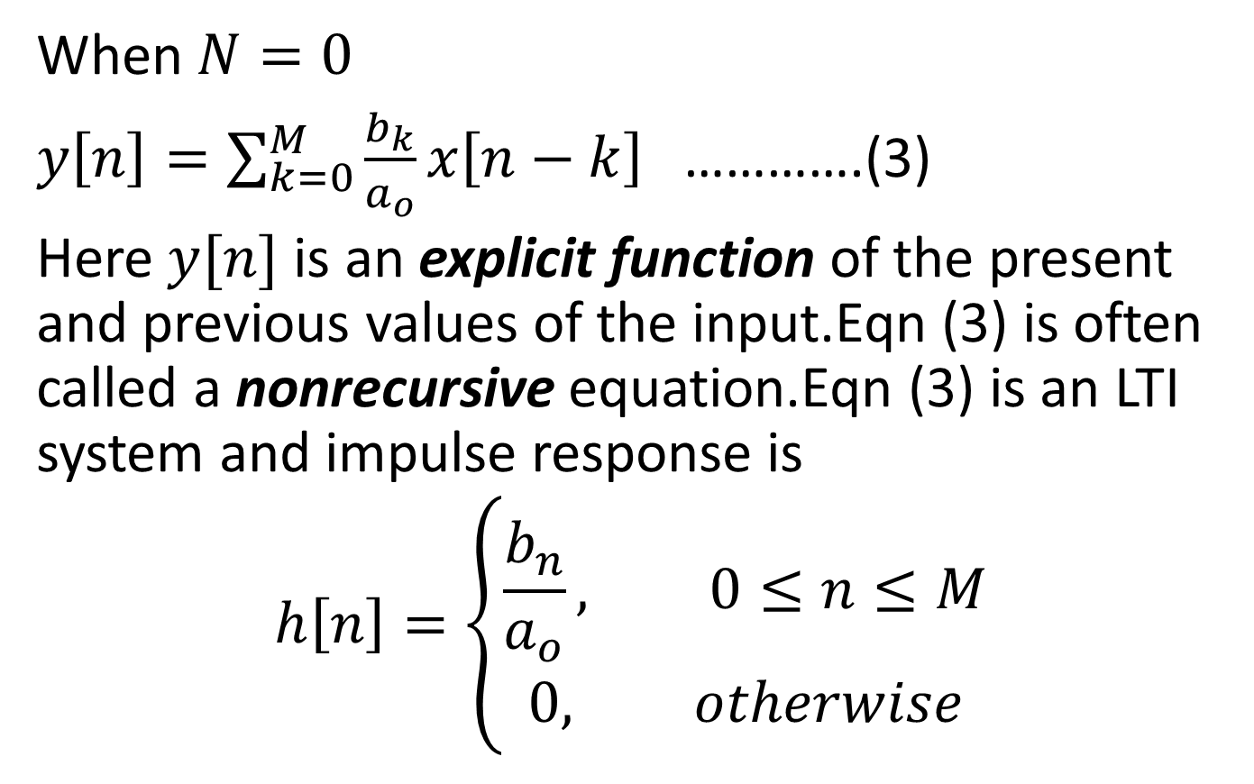
When $N=0$
$y\left[n\right]=\sum_{k=0}^{M}{\frac{b_{k}}{a_{o}}x\left[n−k\right] }$………….(3)
Here $y[n]$ is an explicit function of the present and previous values of the input.Eqn (3) is often called a nonrecursive equation.Eqn (3) is an LTI system and impulse response is
$$h\left[n\right]=\left\{\begin{aligned}\frac{b_{n}}{a_{o}}, 0≤n≤M \\ 0, otherwise\end{aligned}\right.$$

Slide 9
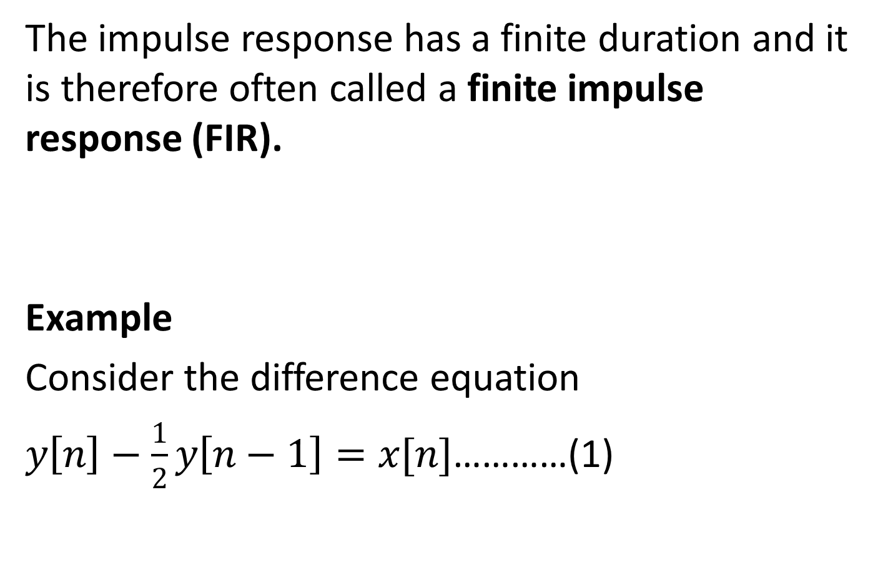
The impulse response has a finite duration and it is therefore often called a finite impulse response (FIR).
Example
Consider the difference equation
$y\left[n\right]−\frac{1}{2}y\left[n−1\right]=x[n]$…………(1)

Slide 10
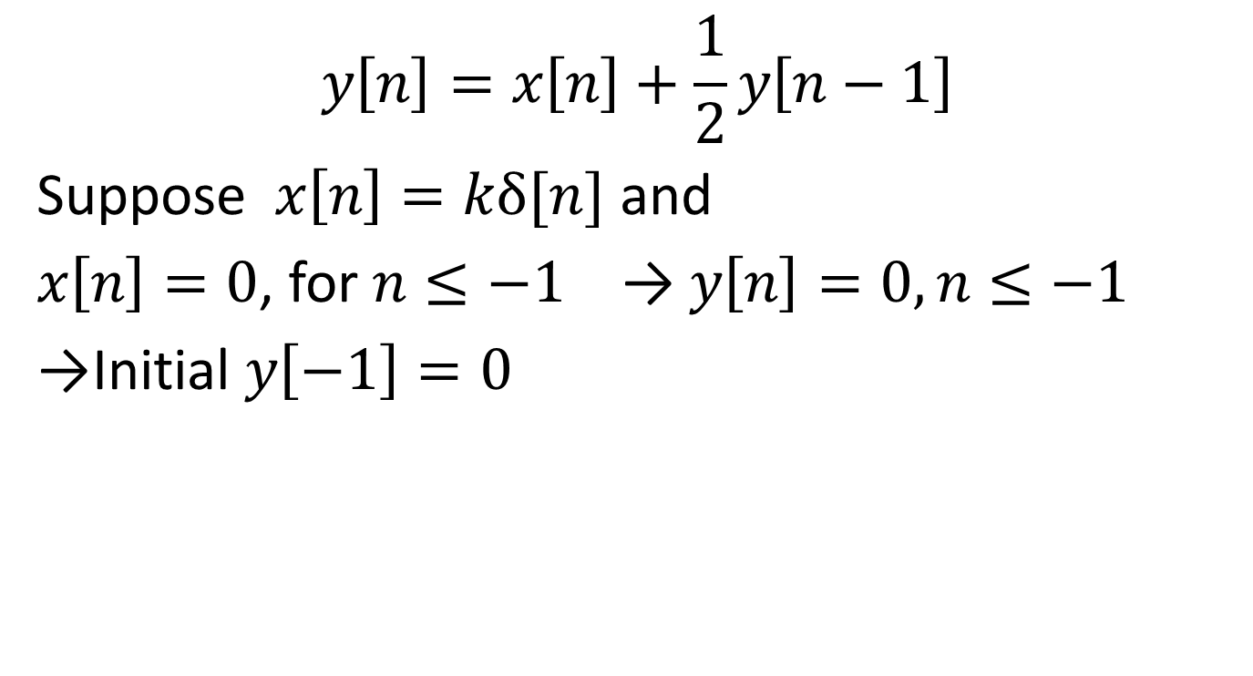
Solution
$$y\left[n\right]=x\left[n\right]+\frac{1}{2}y\left[n−1\right]$$
Suppose $x\left[n\right]=kδ[n]$ and
$x\left[n\right]=0$, for $n≤−1$ → $y\left[n\right]=0, n≤−1$
→Initial $y\left[−1\right]=0$

Slide 11
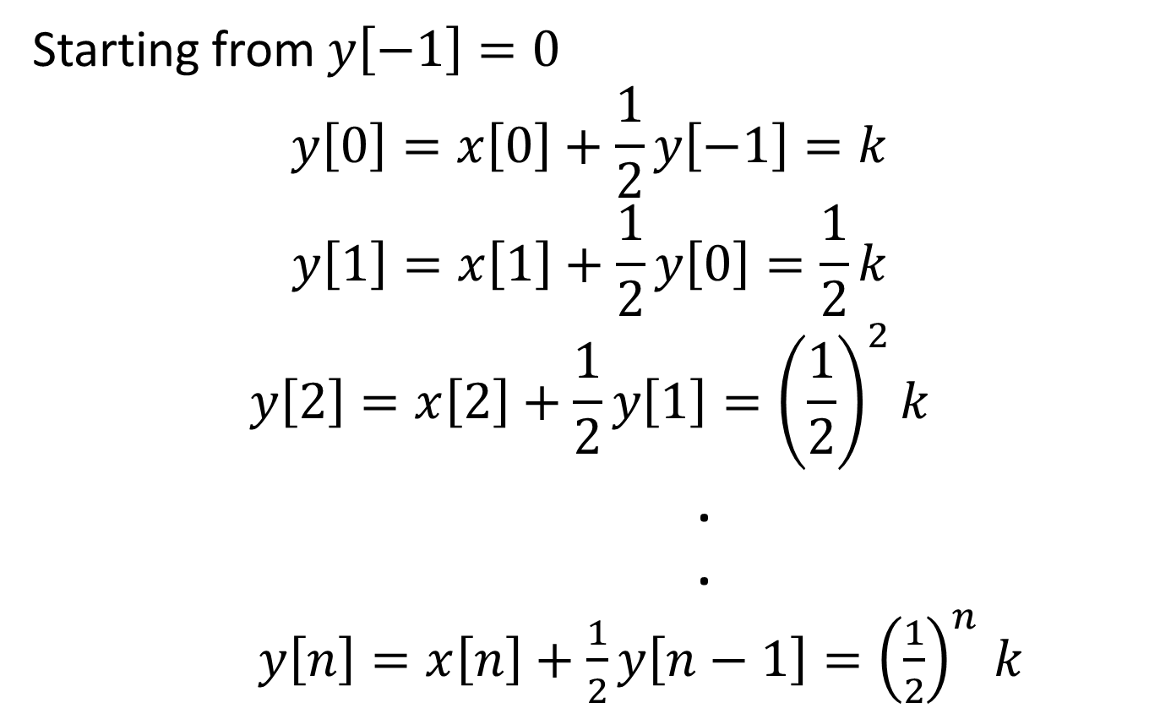
Starting from $y\left[−1\right]=0$
$$y\left[0\right]=x\left[0\right]+\frac{1}{2}y\left[−1\right]=k$$
$$y\left[1\right]=x\left[1\right]+\frac{1}{2}y\left[0\right]=\frac{1}{2}k$$
$$y\left[2\right]=x\left[2\right]+\frac{1}{2}y\left[1\right]={\left(\frac{1}{2}\right)}^{2}k$$
.
.
$y\left[n\right]=x\left[n\right]+\frac{1}{2}y\left[n−1\right]{=\left(\frac{1}{2}\right)}^{n}k$

Slide 12
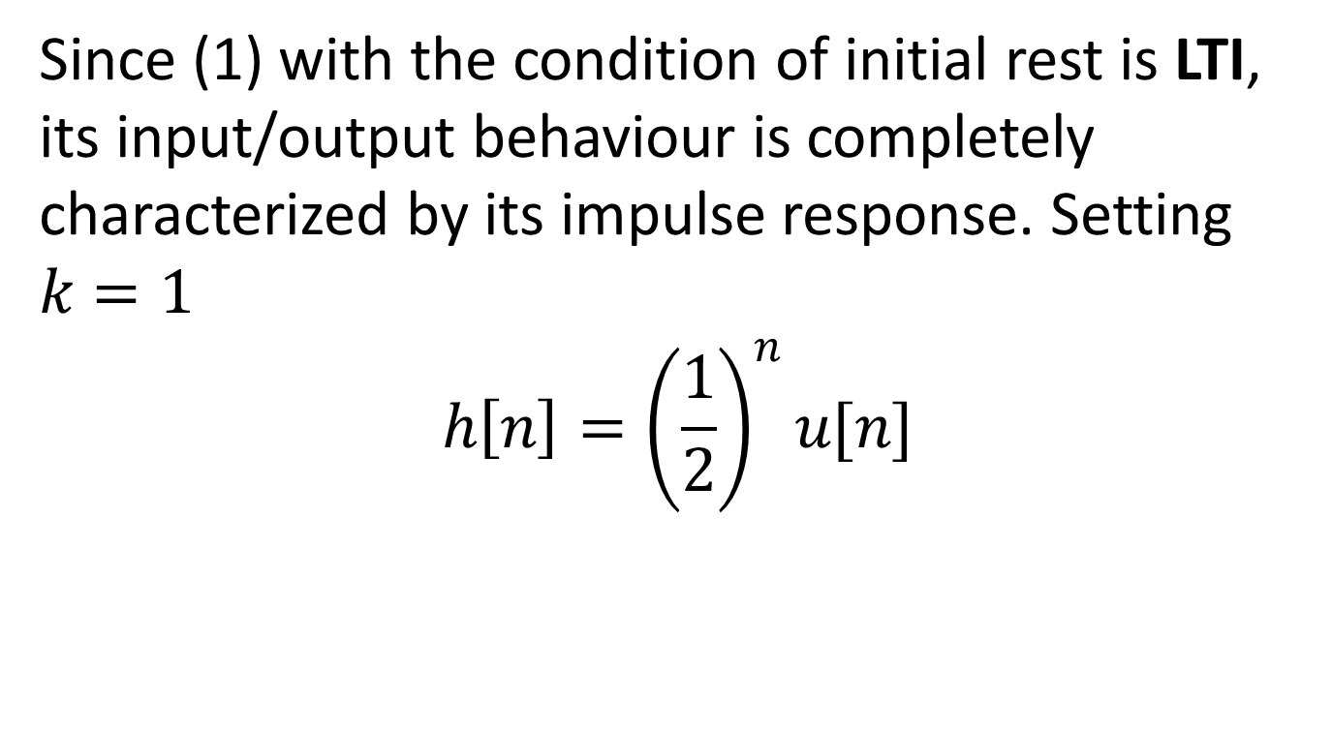
Since (1) with the condition of initial rest is LTI, its input/output behaviour is completely characterized by its impulse response. Setting $k=1$
$$h\left[n\right]={\left(\frac{1}{2}\right)}^{n}u[n]$$

Slide 13

Example 2
Consider the Causal LTI system whose input $x[n]$ and output $y[n]$ are related by the difference equation. $y\left[n\right]=\frac{1}{4}y\left[n−1\right]+x[n]$ .Determine $y\left[n\right] if x\left[n\right]=δ[n−1]$

Slide 14
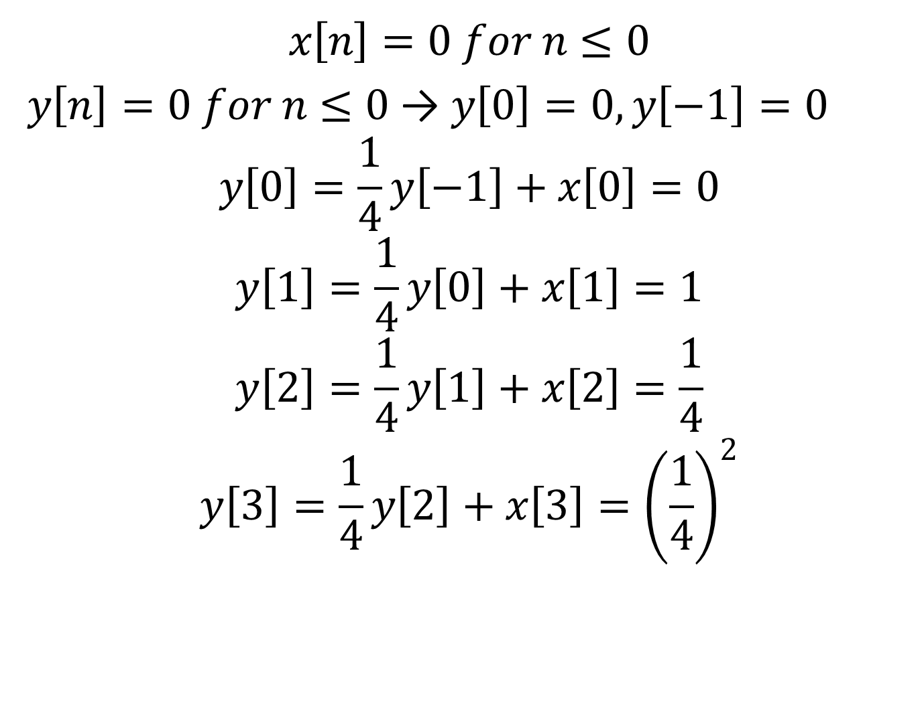
Solution
$$x\left[n\right]=0 for n≤0$$
$y\left[n\right]=0 for n≤0$ → $y\left[0\right]=0, y\left[−1\right]=0$
$$y\left[0\right]=\frac{1}{4}y\left[−1\right]+x\left[0\right]=0$$
$$y\left[1\right]=\frac{1}{4}y\left[0\right]+x\left[1\right]=1$$
$$y\left[2\right]=\frac{1}{4}y\left[1\right]+x\left[2\right]=\frac{1}{4}$$
$$y\left[3\right]=\frac{1}{4}y\left[2\right]+x\left[3\right]={\left(\frac{1}{4}\right)}^{2}$$

Slide 15
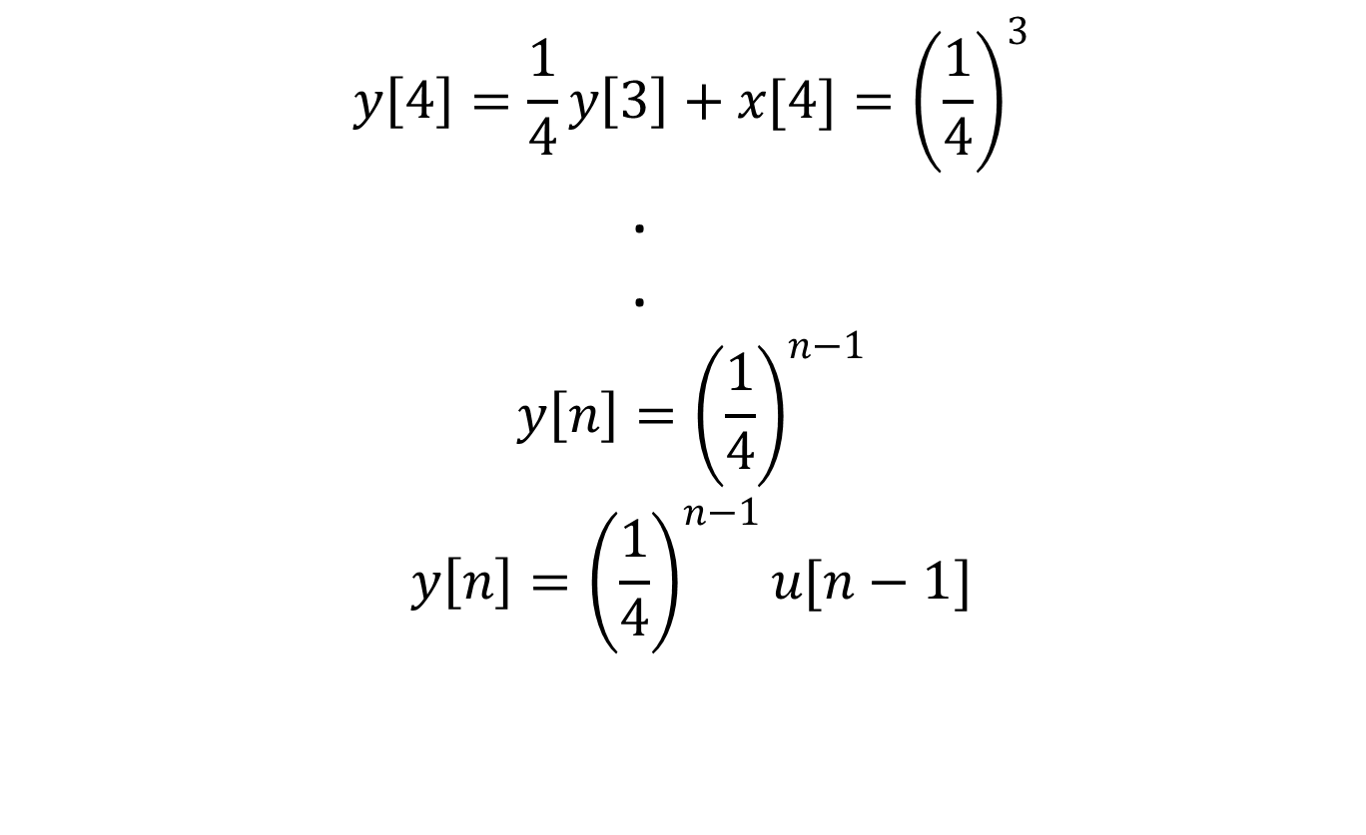
$$y\left[4\right]=\frac{1}{4}y\left[3\right]+x[4]={\left(\frac{1}{4}\right)}^{3}$$
.
.
$${y\left[n\right]=\left(\frac{1}{4}\right)}^{n−1}$$
$${y\left[n\right]=\left(\frac{1}{4}\right)}^{n−1}u[n−1]$$

